Slide 1


SRI RAMAKRISHNA INSTITUTE OF TECHNOLOGY
(An Autonomous Institution)
Pachapalayam, Perur Chettipalayam, Coimbatore- 641 010
DEPARTMENT OF COMPUTER SCIENCE AND ENGINEERING
20CS902-FYP Phase I First Review BATCH NO :39
ADDRESSING THE INCOME GAP CAUSED BY MIDDLEMEN IN AGRICULTURAL MARKETING THROUGH DIRECT FARMER-TO- CONSUMER SOLUTIONS
Presented by:
Guided by:
VIGNESHWARAN | S | - | 71382202173
SARUKESH A |  | - | 71382202134
SOORAJ R NAIR |  | - | 71382202152
SANJAY S | - 71382202130
MRS A JAYASMRUTHI
Assistant Professor Department of CSE

Slide 2
CONTENT OUTLINE
Introduction
Project Overview
Literature Review
Methodology
System Architecture
Implementation Details
Results
Evaluation
Conclusion
References

Slide 3
INTRODUCTION
Empowering Farmers Digitally: Aggregate Argo connects farmers directly with consumers, offering smart inventory
tools, profile management, and easy product listings — all from a simple login.
Smart Shopping for Customers: With a user-friendly interface, customers can browse a wide range of vegetables, place quick orders, and track deliveries seamlessly.
Admin in Control: The robust admin dashboard allows full control over user access, product catalogs, and real-time
order and payment management.
Boosting Agro-Economy: By streamlining logistics for delivery staff and opening larger markets for farmers, this platform drives sustainability and growth in the agri-trade.

Slide 4
PROJECT OVERVIEW
Farmer Empowerment Tool: Provide features such as farmer registration, product listing, inventory tracking, pricing control, and order management to give farmers full control over their sales.
User-Friendly Consumer Experience: Facilitate easy browsing, purchasing, and delivery tracking for consumers, improving transparency and trust in the supply chain.
Secure Digital Transactions: Enable secure, traceable online payments for buyers and ensure transparent payouts to farmers.
TOOLS AND TECHNOLOGIES
Javascript
Node.js
React.js
MongoDB

Slide 5
LITERATURE REVIEW
S.NO | PAPER DETAILS | YEAR | AUTHOR | INFERENCE
1 | E-Commerce for Farmer To Consumer | 2025 | Venkata Rami Reddy Naru Dasari Sasi Venkat Gowd | FPOs using digital platforms improve collective bargaining, reduce transaction costs, and enable direct selling, minimizing the role of middlemen.
2 | Web Based Application for Direct Market Access For Farmers | 2025 | Abishek S Aswinraj S V | Web based application for direct market access for farmers aims to provide a digital platform for individual consumers and their benefits
3 | Enhancing Farmer to To Consumer Connectivity Through Smart E- Commerce Platform | 2024 | Mehul Patil Shams Mansoori | Smart E-commerce Platform to connect farmers and consumers without middleman

Slide 6
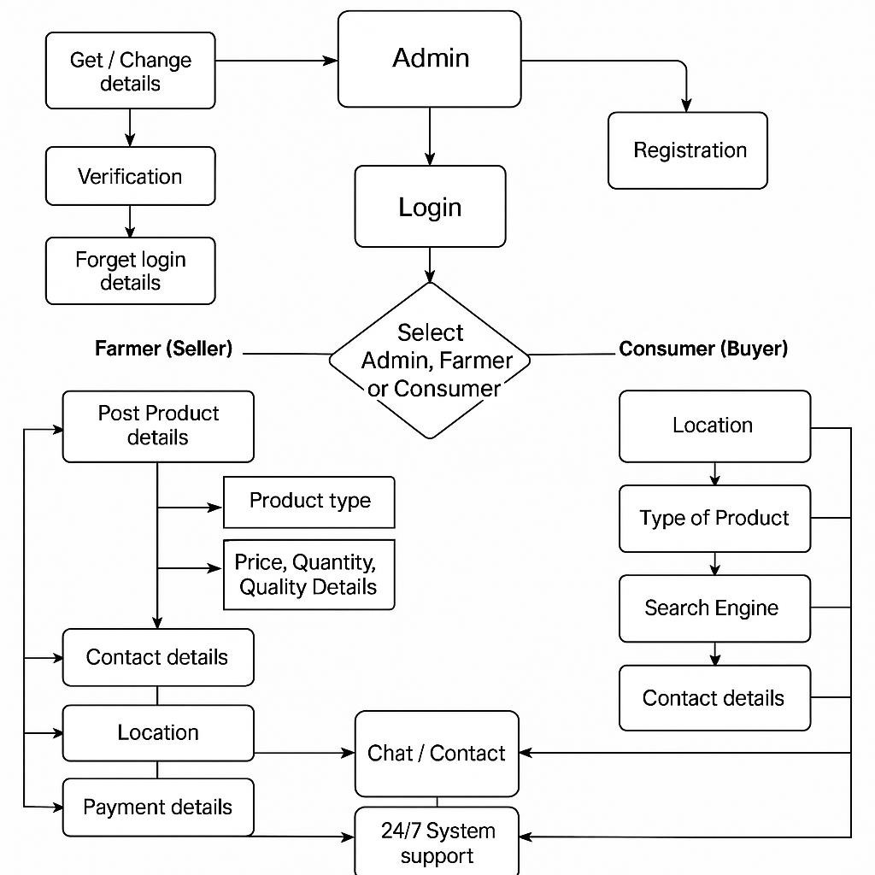
METHODOLOGY

Slide 7
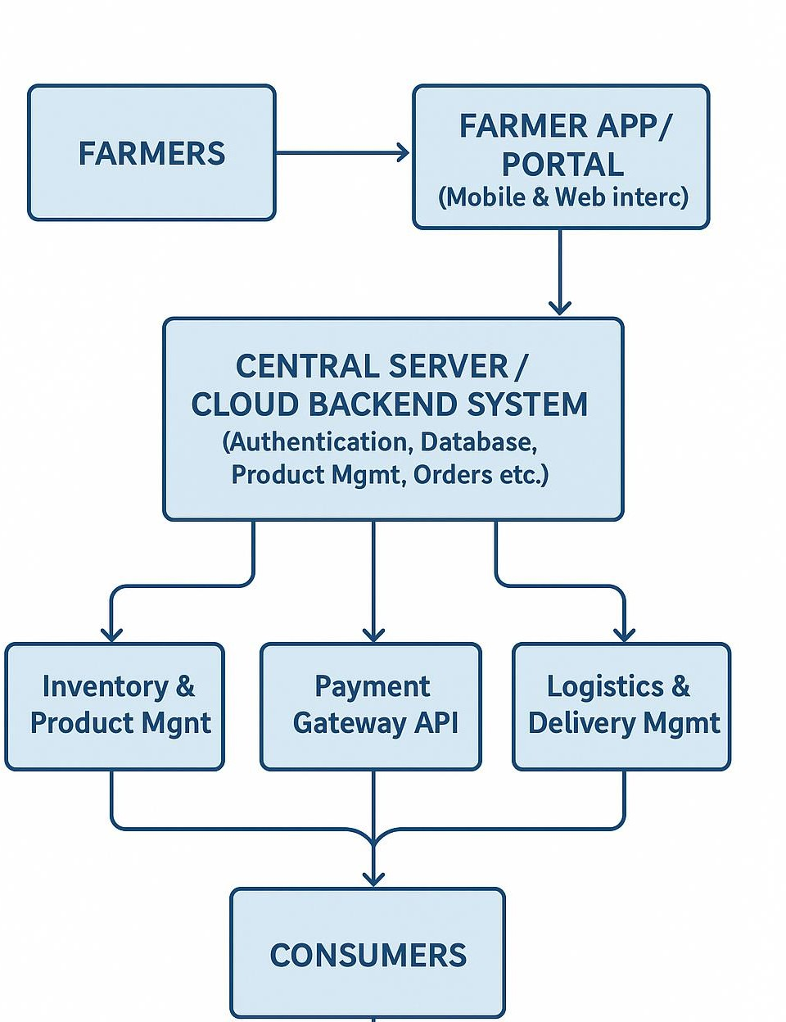
SYSTEM ARCHITECTURE

Slide 8
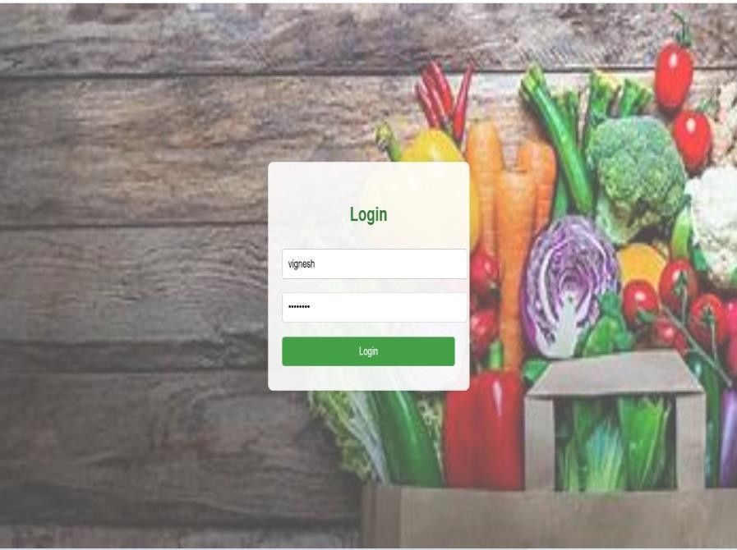
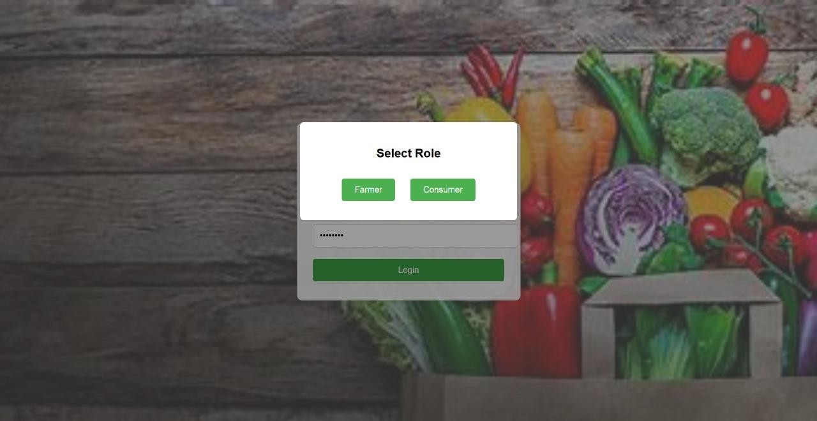
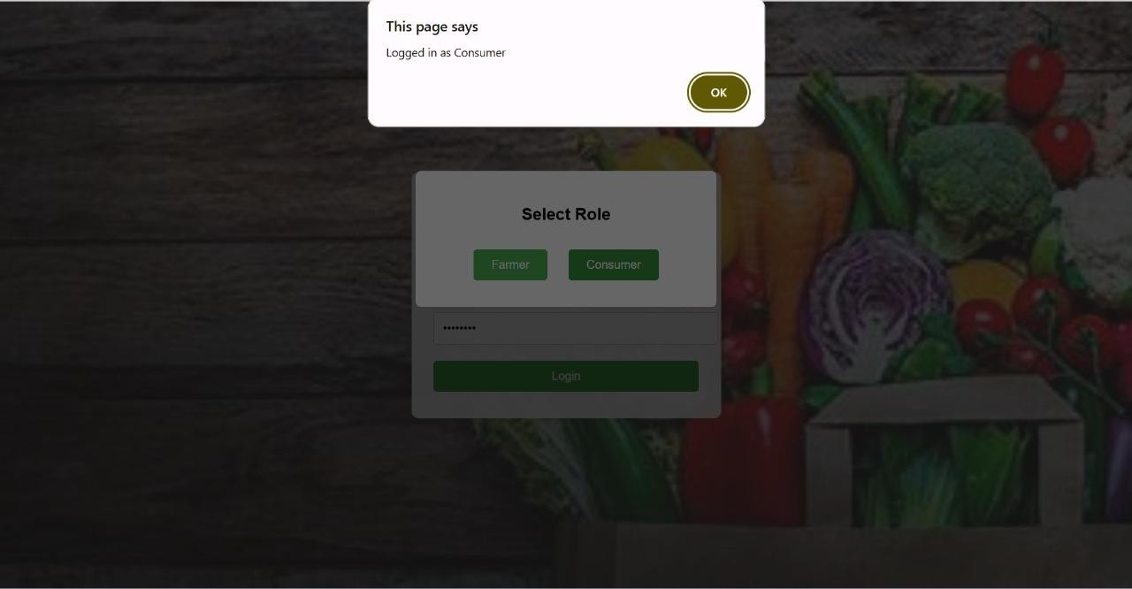
IMPLEMENTATION DETAILS

Slide 9
RESULTS
Increased Farmer Income
Consumer Benefits
Digital Empowerment of Farmers
Reduction in Market Exploitation
Scalable and Replicable Model

Slide 10
EVALUATION
Addresses a real-world problem that affects millions of small and marginal farmers
High social impact: aims to improve farmers’ income and reduce consumer prices.
Contributes to sustainable development and rural empowerment.
Proposes a digital platform (mobile/web) to enable direct transactions.
Consumers get fresher produce at lower or fairer prices.
Helps in reducing food waste due to faster and direct delivery.

Slide 11
CONCLUSION
Farmers are the backbone of our nation — this solution gives them the power to grow not just crops, but their income too.
By removing middlemen, the produce reaches consumers faster, fresher, and fairer.
Technology becomes the new tool alongside ploughs — helping farmers trade smartly and efficiently.
Consumers get better quality at better prices, and farmers get better returns — a cycle of trust and benefit.
BATCH ID : 11

Slide 12
REFERENCES
D. S. V. Gowd, N. V. R. Reddy and K. Aravind, “Farmer To Consumer,” Conference Paper, Parul University, Mar. 2025.
P. Kushwaha, S. Mansoori, M. Patil, and R. Baheti “Transforming Agriculture: Enhancing Farmer-to-Consumer Connectivity Through Smart E-Commerce Platforms” Int. J. Sci. Res. Eng. Manag., vol. 9, no. 4, pp. 1–2, Apr. 2025.
A. S., A. S. V., M. M., and A. Jeyamurugan, “Web Based Application for Direct Market Access for Farmers,” Int. J. Creates. Thoughts, vol. 13, no. 4, pp. 192–197, Apr. 2025.
N. Anusha, P. S. Keerthi, M. R. Reddy, A. Ramesh, and M. R. Ignatious, “Farm to Home: An E-commerce Application for Farmers and Consumers,” in Advances in Computational Intelligence and its Applications, May 2024. DOI: 10.1201/9781003488682-5.
S. Uplaonkar and S. Biradar, “Middleman Growth in Agricultural Field and Its Impact on Farmers,” Int. J. Creat. Res. Thoughts, vol. 8, no. 3, pp. 3314–3317, Mar. 2020.
01/08/2025
BATCH ID : 39
12

Slide 13
THANK YOU
01/08/2025
BATCH ID : 39
13

